Slide 1
16s Microbiome Analysis Workshop
Alana Schick Gut4Health
July 18-20, 2022
Disclaimer: These slides are taken from difference sources on the web and some are modified. I have added sources but if I have missed some, I apologize in advance to the original content creators.

Slide 2
Analyzing the microbiome
Who lives here?
Over time + Treatment

Slide 3
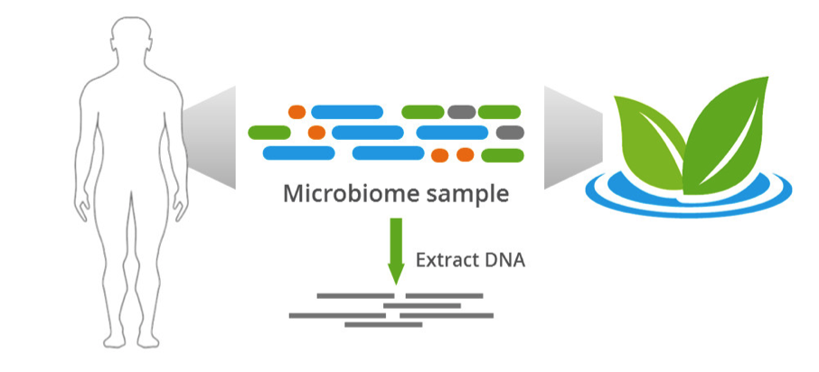
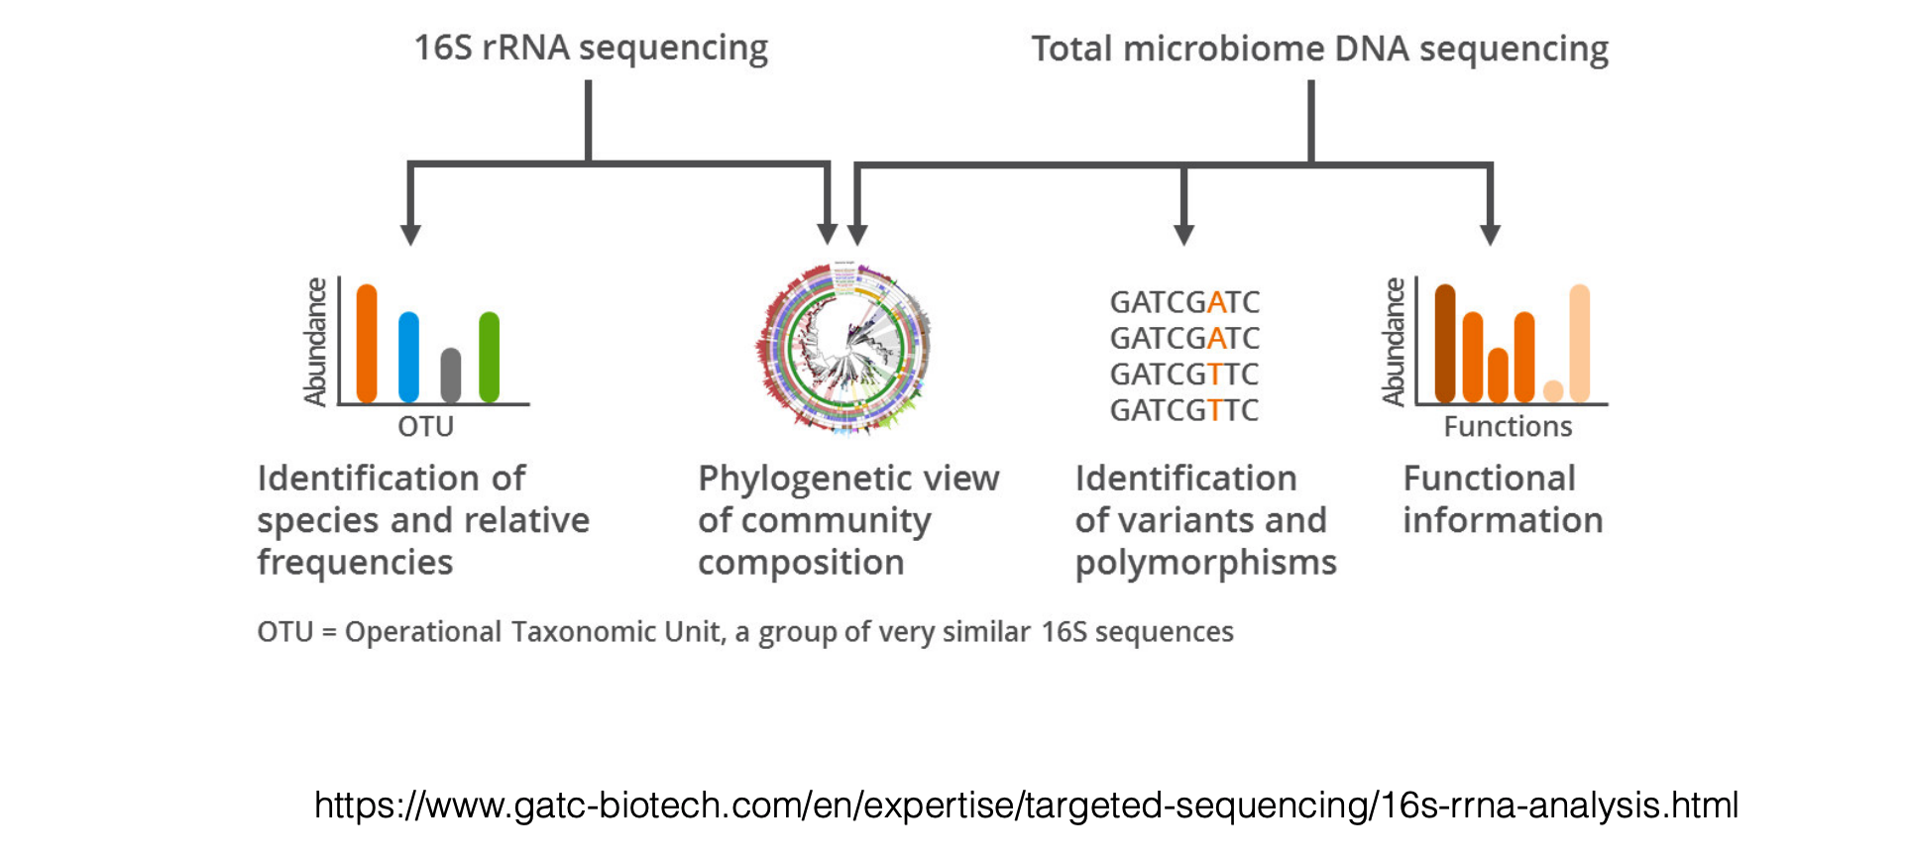
Amplicon Sequencing
Total microbiome DNA sequencing

Slide 4
Amplicon Sequencing
What should we amplify?

Slide 5
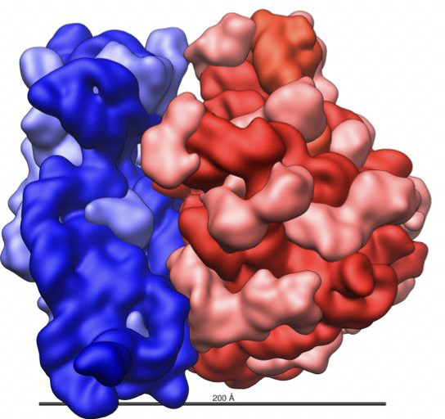
An E. coli ribosome
Small subunit
Large subunit
16S rRNA
https://commons.wikimedia.org/wolo/File:Ribosome_shape.png

Slide 6
Why 16S rRNA
rRNA is one of the few gene products present in all cells
16S rRNA has 9 hypervariable regions allowing species identification, as well as conserved regions allowing primer construction
conserved function
sequence has been characterized for many species

Slide 7
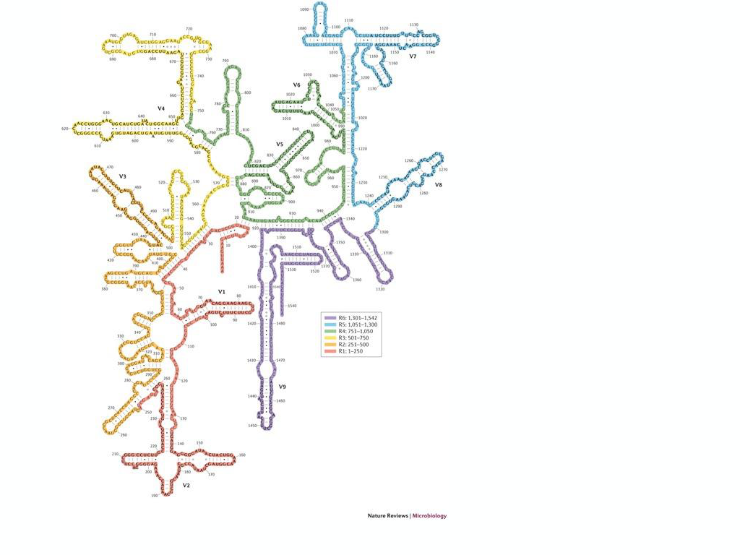
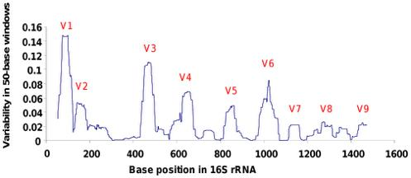
16S rRNA
Yarsa et al., Nature Rev Microbiology 2014; Bodilis et al., PLoS One 2012

Slide 8
16S is not perfect
0
1500 bp
V1
V2
V3
V4
V5
V6
V7
V8
V9
Conserved Regions Variable Regions
16S doesn’t capture all differences between the full DNA sequences
Different species can have similar 16S sequences
A single species can have paralogs that are not identical
Results can depend on which variable region is considered

Slide 9
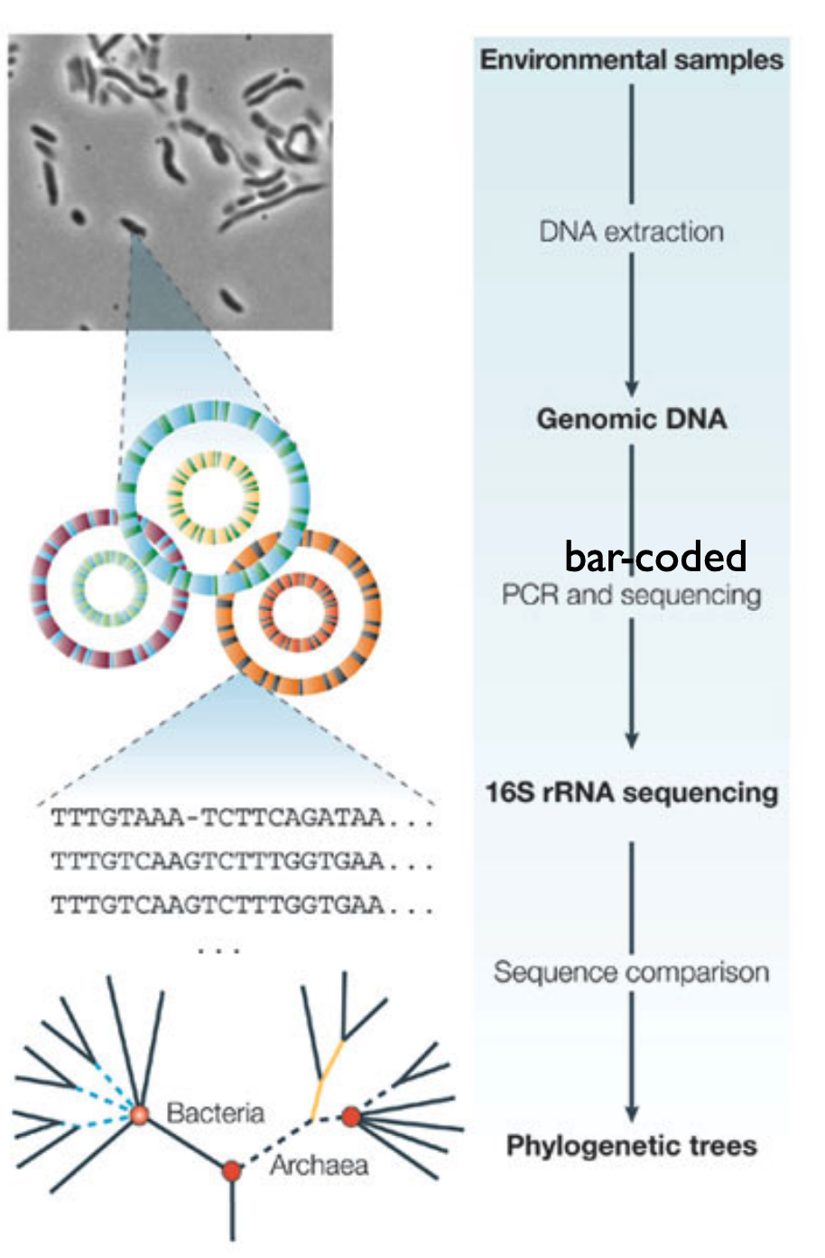
Many microbiomes in parallel
Break all cells, extract all DNA
PCR-amplify 16s rRNA genes using bar-coded primers
Sequence samples
Cluster sequences after De-multiplexing for each sample
Count each species
https://www.biostat.washington.edu/sites/default/files/modules/2018-SISMID-01b.pdf

Slide 10
1
2
Sequencing results
Woah! That is a lot of data
3
4
Bioinformatics Tools
Biological Knowledge
Source: LEGO+Johnathan Irish

Slide 11
Thoughtful data analysis is critical for successful taxonomic assignment

Slide 12
What do we know about our data?
16s Region
Which region was sequenced, read length & depth
Negative Controls
Was a negative control included?
Feasibility
Will this data answer the questions asked by the investigator?
Read Assignment
Are the reads assigned correctly to each sample?
Sample size
Are there enough samples for down stream analysis

Slide 13
16 rRNA
0
1500 bp
V1
V2
V3
V4
V5
V6
V7
V8
V9
Conserved Regions Variable Regions
Pick a variable region
V3-V4
Pick a sequencing technique
Illumina (MiSeq)
Select primers & Read lengths
Overlap
FWD
Primer
Read length
Primer
REV
Make sure there is an overlap!!!!

Slide 14
How to calculate V region overlap
Overlap
FWD
Primer
Read length
Primer
REV
Overlap = Read length X 2 – primer_F – primer_R – VR_length
Example: V4
VR_length = 254 bp
read length = 250 x 2 bp and
primers = 20 bp
Overlap= 250 *2 – 20 – 20 – 254 = 206

Slide 15
Typical Workflow

Slide 16
The common path
Reads
Quality
Control
Denoise
Clustering
Classify
Check Read Quality
Correct Errors
Define Clusters
Select Database
Remove Primers
Dereplicate
Check CHIMERA
Assign Taxonomy
Quality Filter & Truncation
Merge Reads
Phix Contamination

Slide 17
Paired End Reads
Overlap
FWD
Primer
Read length
REV
Region | Read length | Amplicon Length | Overlap
V3 | 150 | ~170 | 130
V3-V4 | 300 | ~462 | 133
V4 | 150 | ~254 | 46
V4 | 250 | ~254 | 246
% of bases > Q30
Read Length PE
Source: Illumina
Notes:
The amplicon/fragment is read from either end and this is used to generate the read pairs .

Slide 18
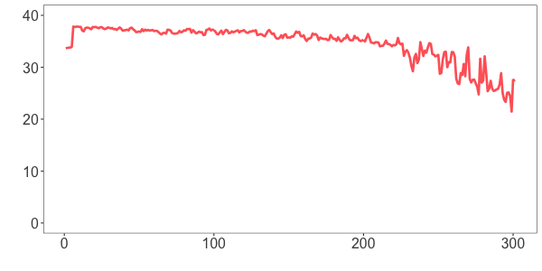
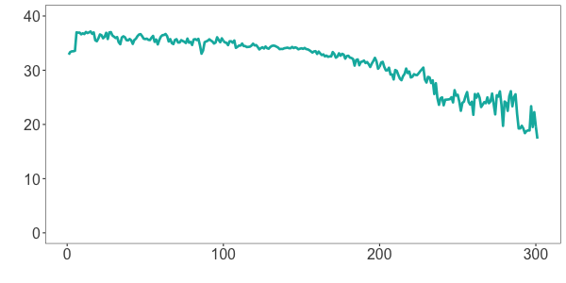
Base Quality differs between Fwd and Rev Reads
Primer
FWD
REV
Average Quality Score
Forward
Reverse
0
100
200
300
400
Base position in a read
Tools
FastQC FastQp MultiQC & Specialized 16s rRNA packages
Source: Dada2 R package

Slide 19
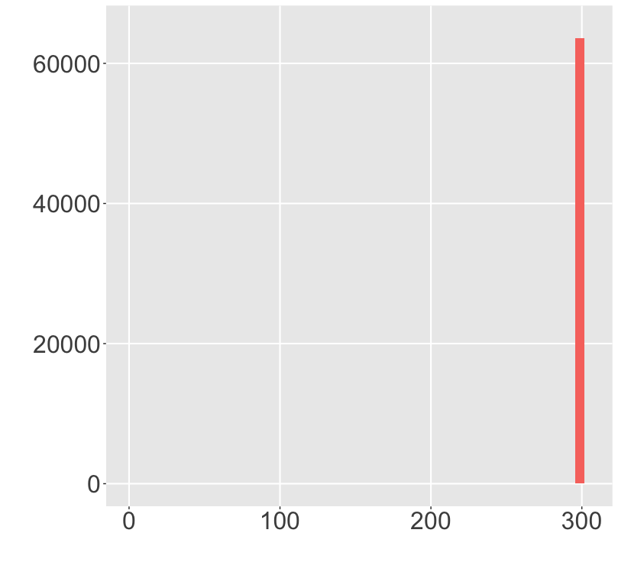
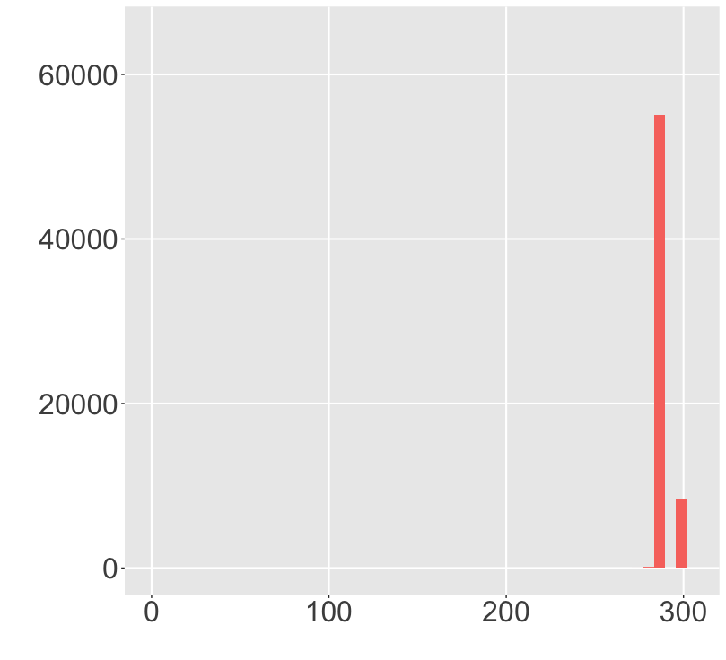
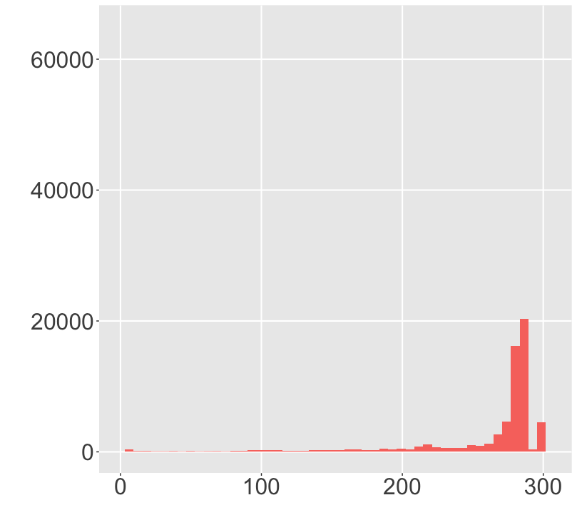
Trimming & Quality Filtering
Raw Reads
Remove Primers
Quality Trimming
Counts
Read Length
Read Length
Read Length
Tools
CutAdapt

Slide 20
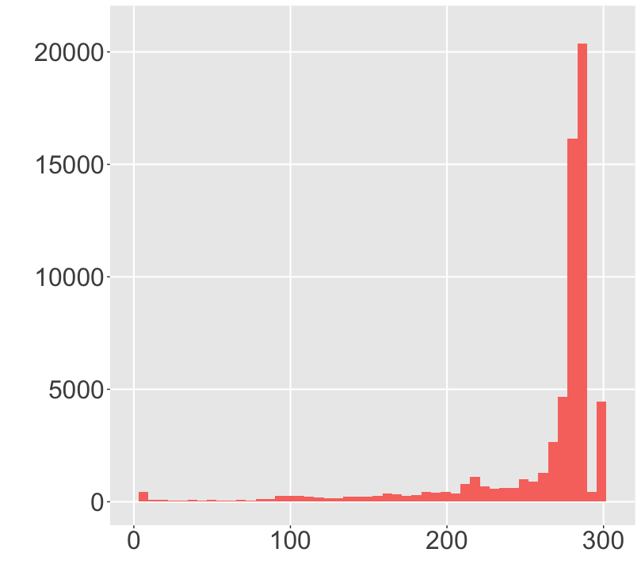
Trimming & Quality Filtering
Available Methods
Minimum Q (Q >= 20)
Truncate if 3 consecutive bases are Q < 3
Expected Errors
Truncation
Counts
Read length | % of reads
10 | 98.96
100 | 96.97
200 | 89.3
250 | 80.5
Read Length
Source: Edgar et al., 2015

Slide 21
Why PhiX?
Caution
Low diversity
Significant number of reads have the same sequence
PhiX Contamination
Illumina removes PhiX
Assigned to samples
(1%-12%)
Quality Control
Cluster Generation
Phasing & Prephasing
Removal
Blast sample reads against PhiX genome
Source: Illumina
Source: Mukherjee et al.,2015
Notes:
Each dna strand in a cluster is extended by one nucleotide, a smalll proporation of strands may out phase the current cycle.

Slide 22
Denoising reads

Slide 23
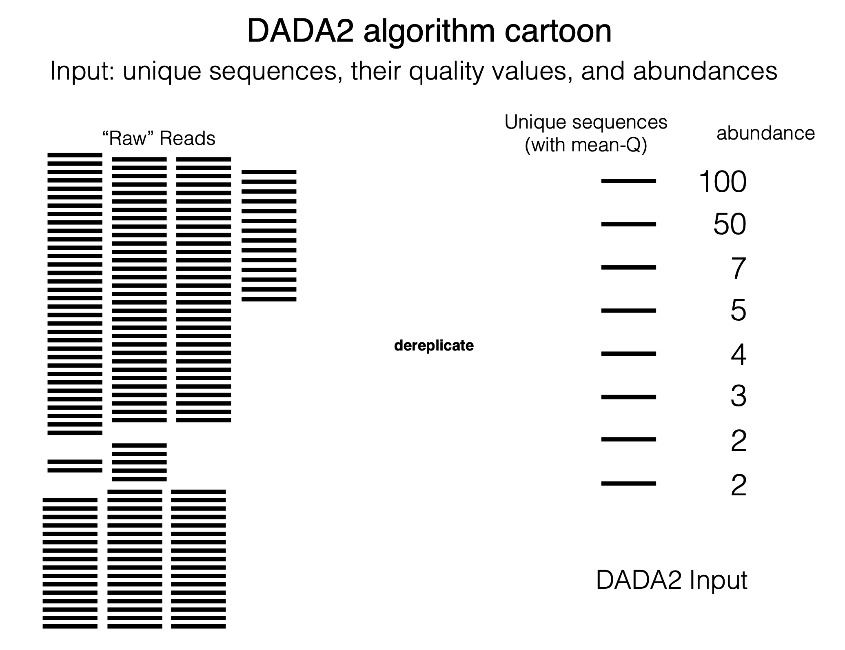

Slide 24
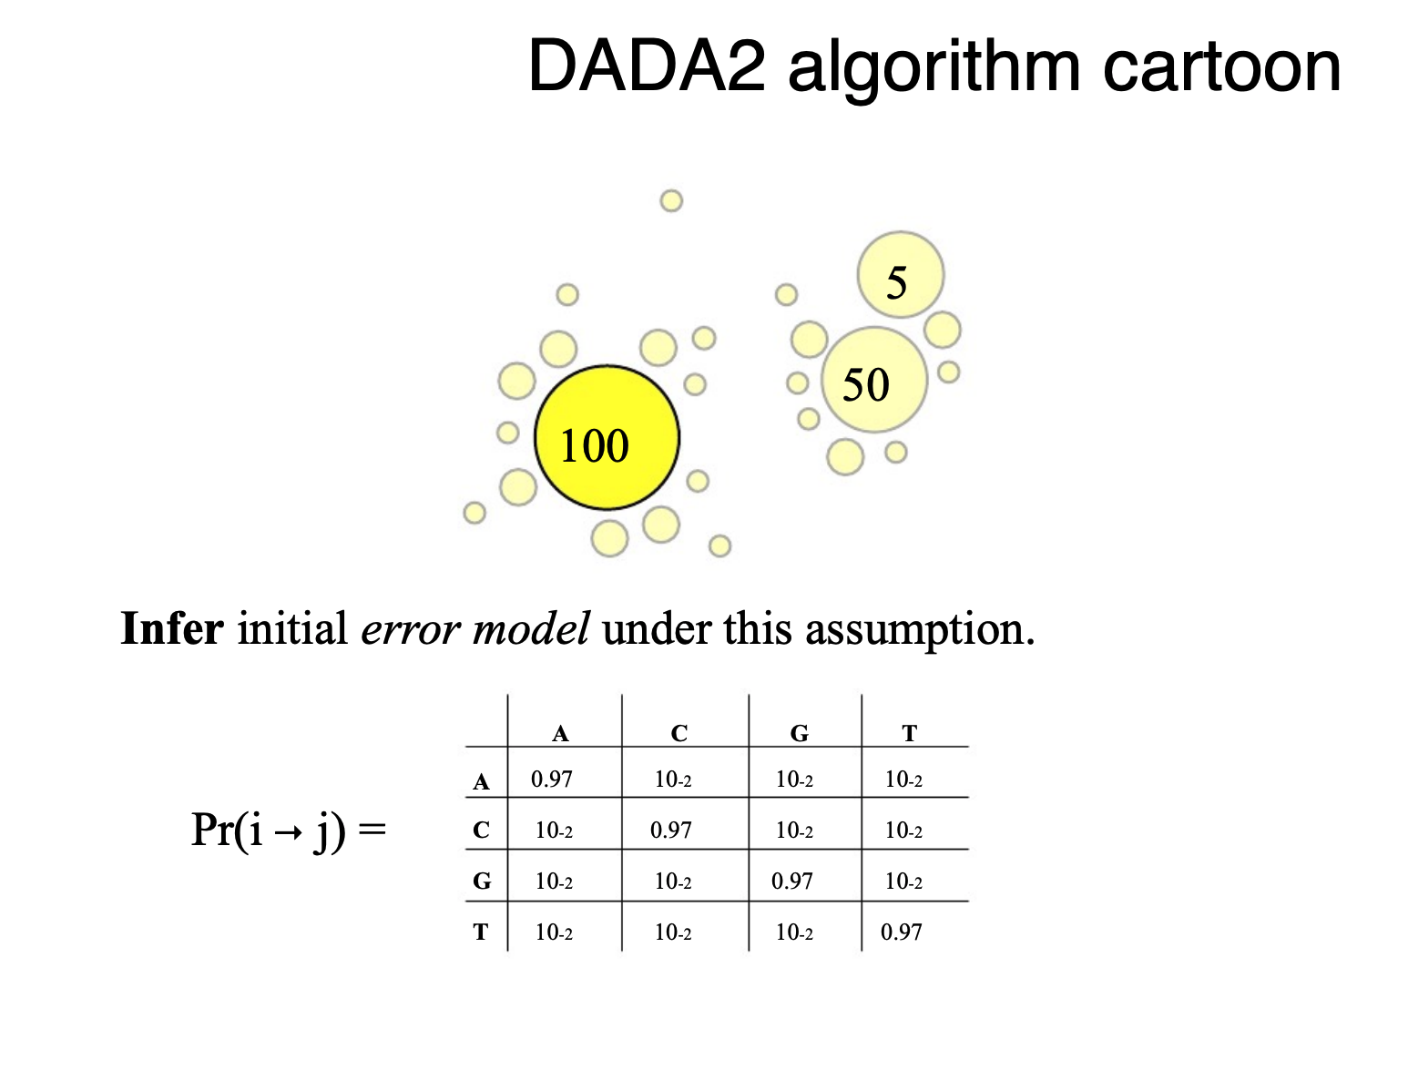
Notes:
Expected abundance of seq i is calculated by assuming that it is generated by errors mulitplied by abundance of j. Is the observed value greater than what you expected? P-values is small means that there are more sequences of j than you expect if they were errors of sequence j give the abundance of it.

Slide 25
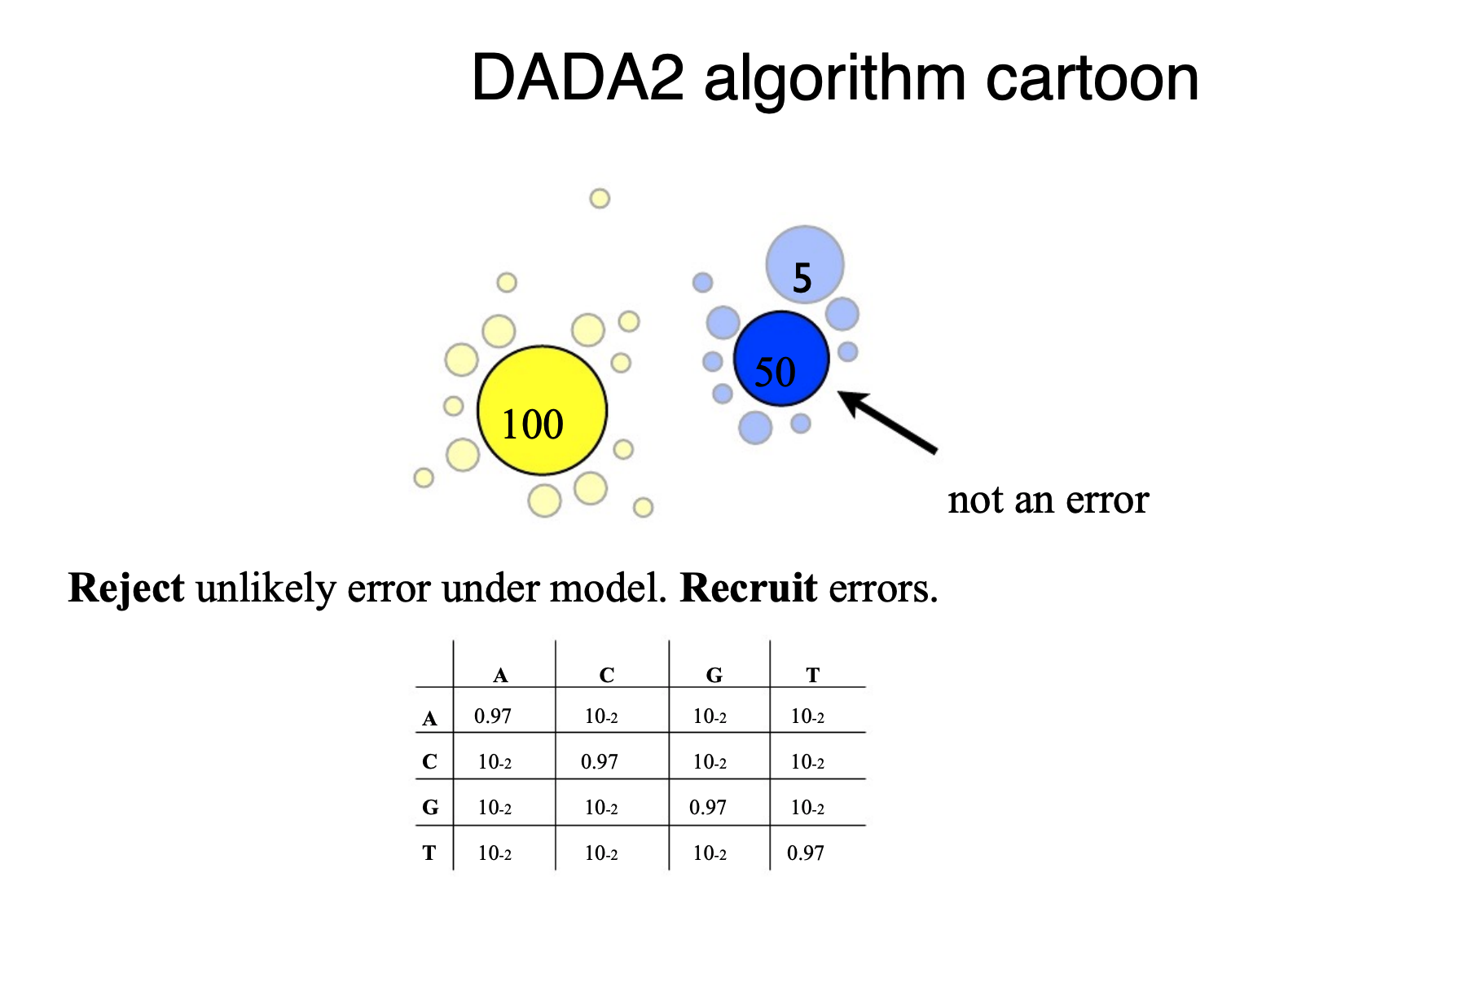

Slide 26
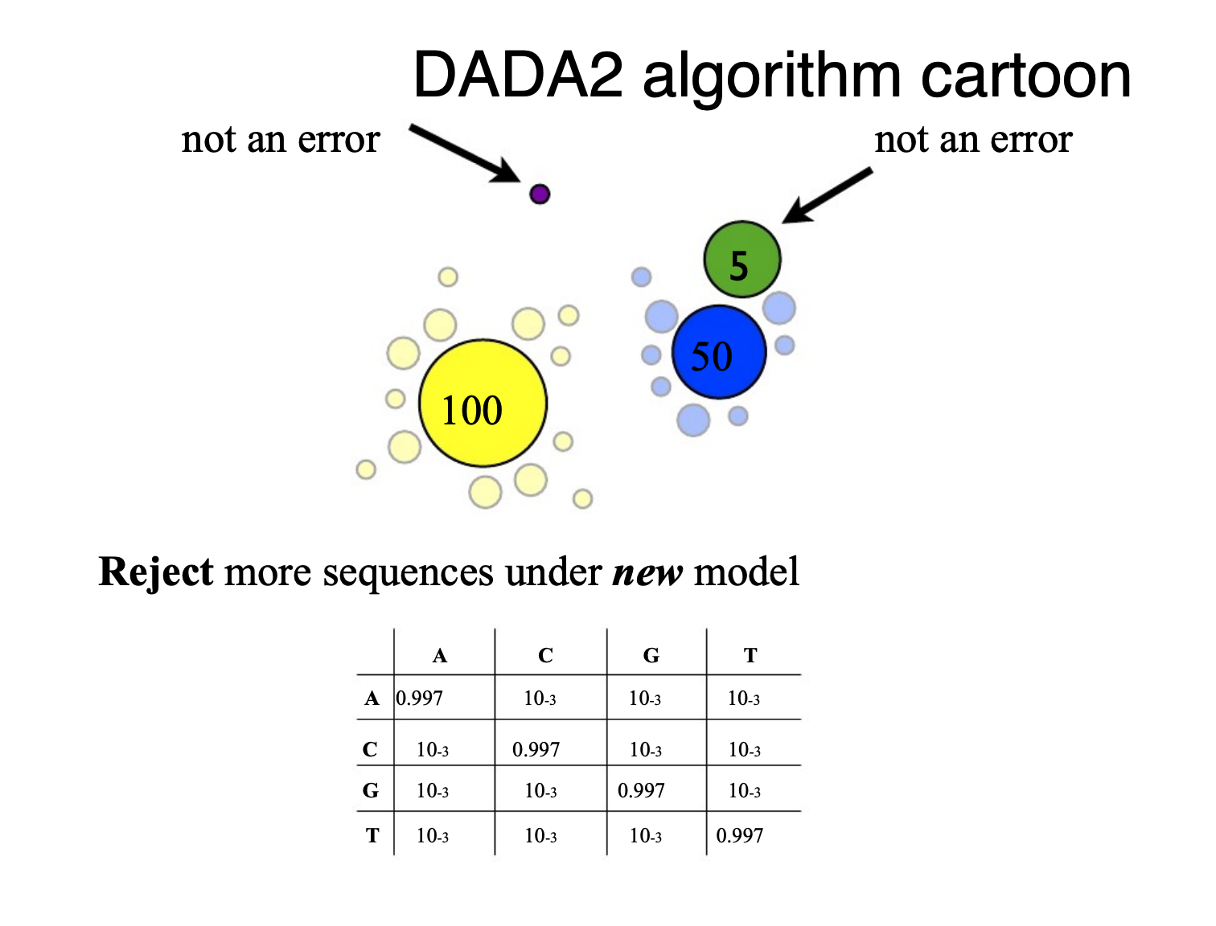

Slide 27
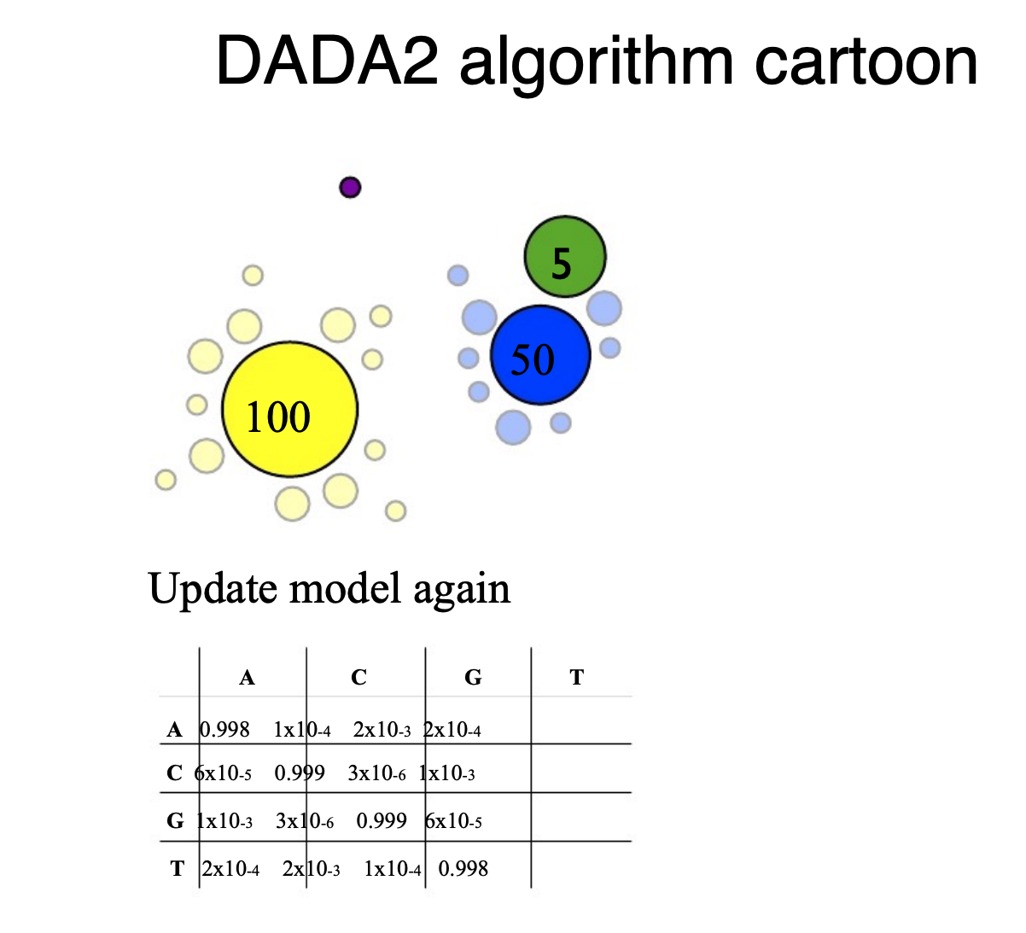

Slide 28
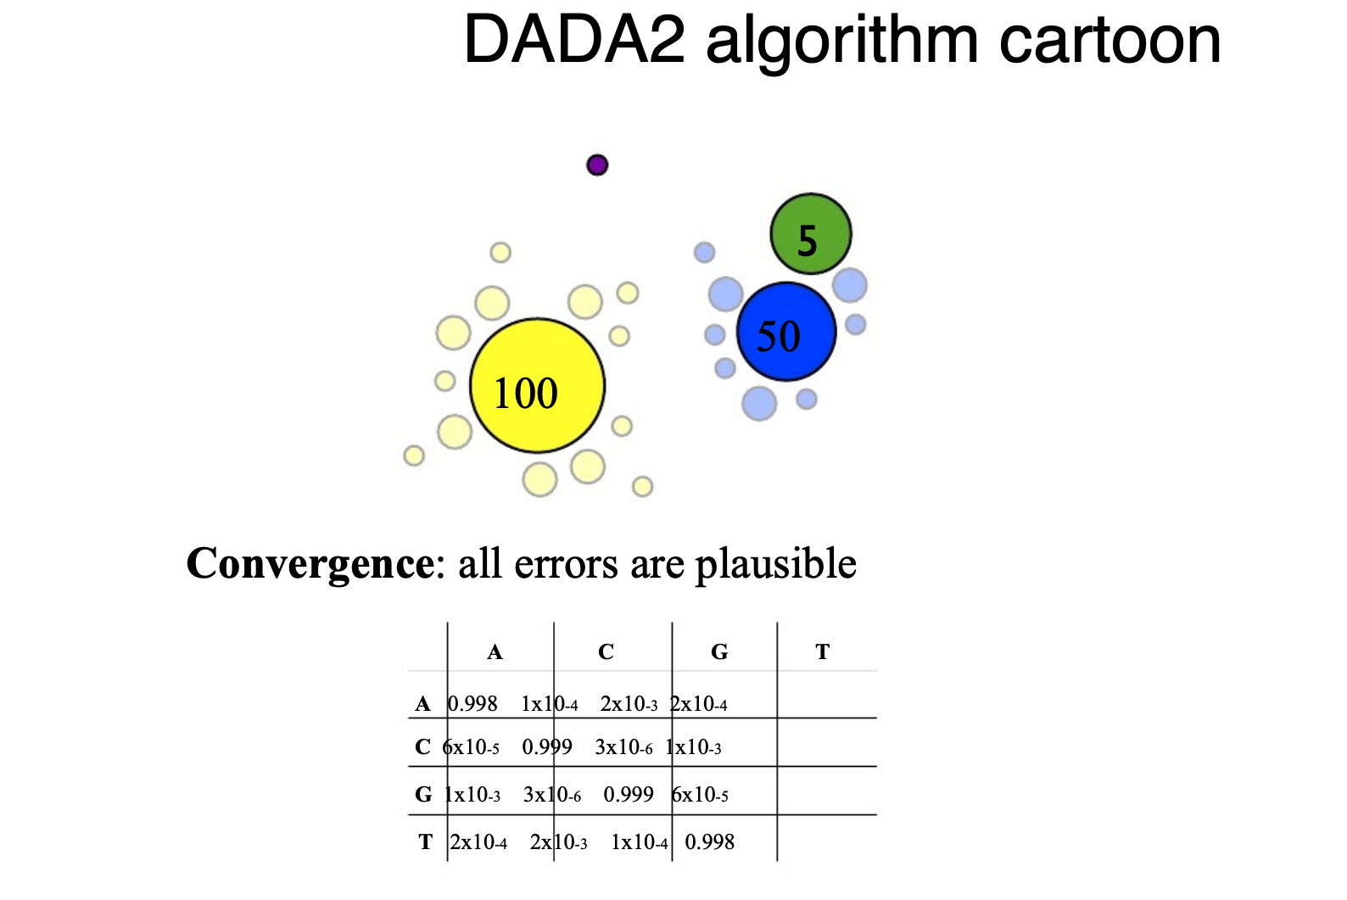

Slide 29
Clustering reads

Slide 30
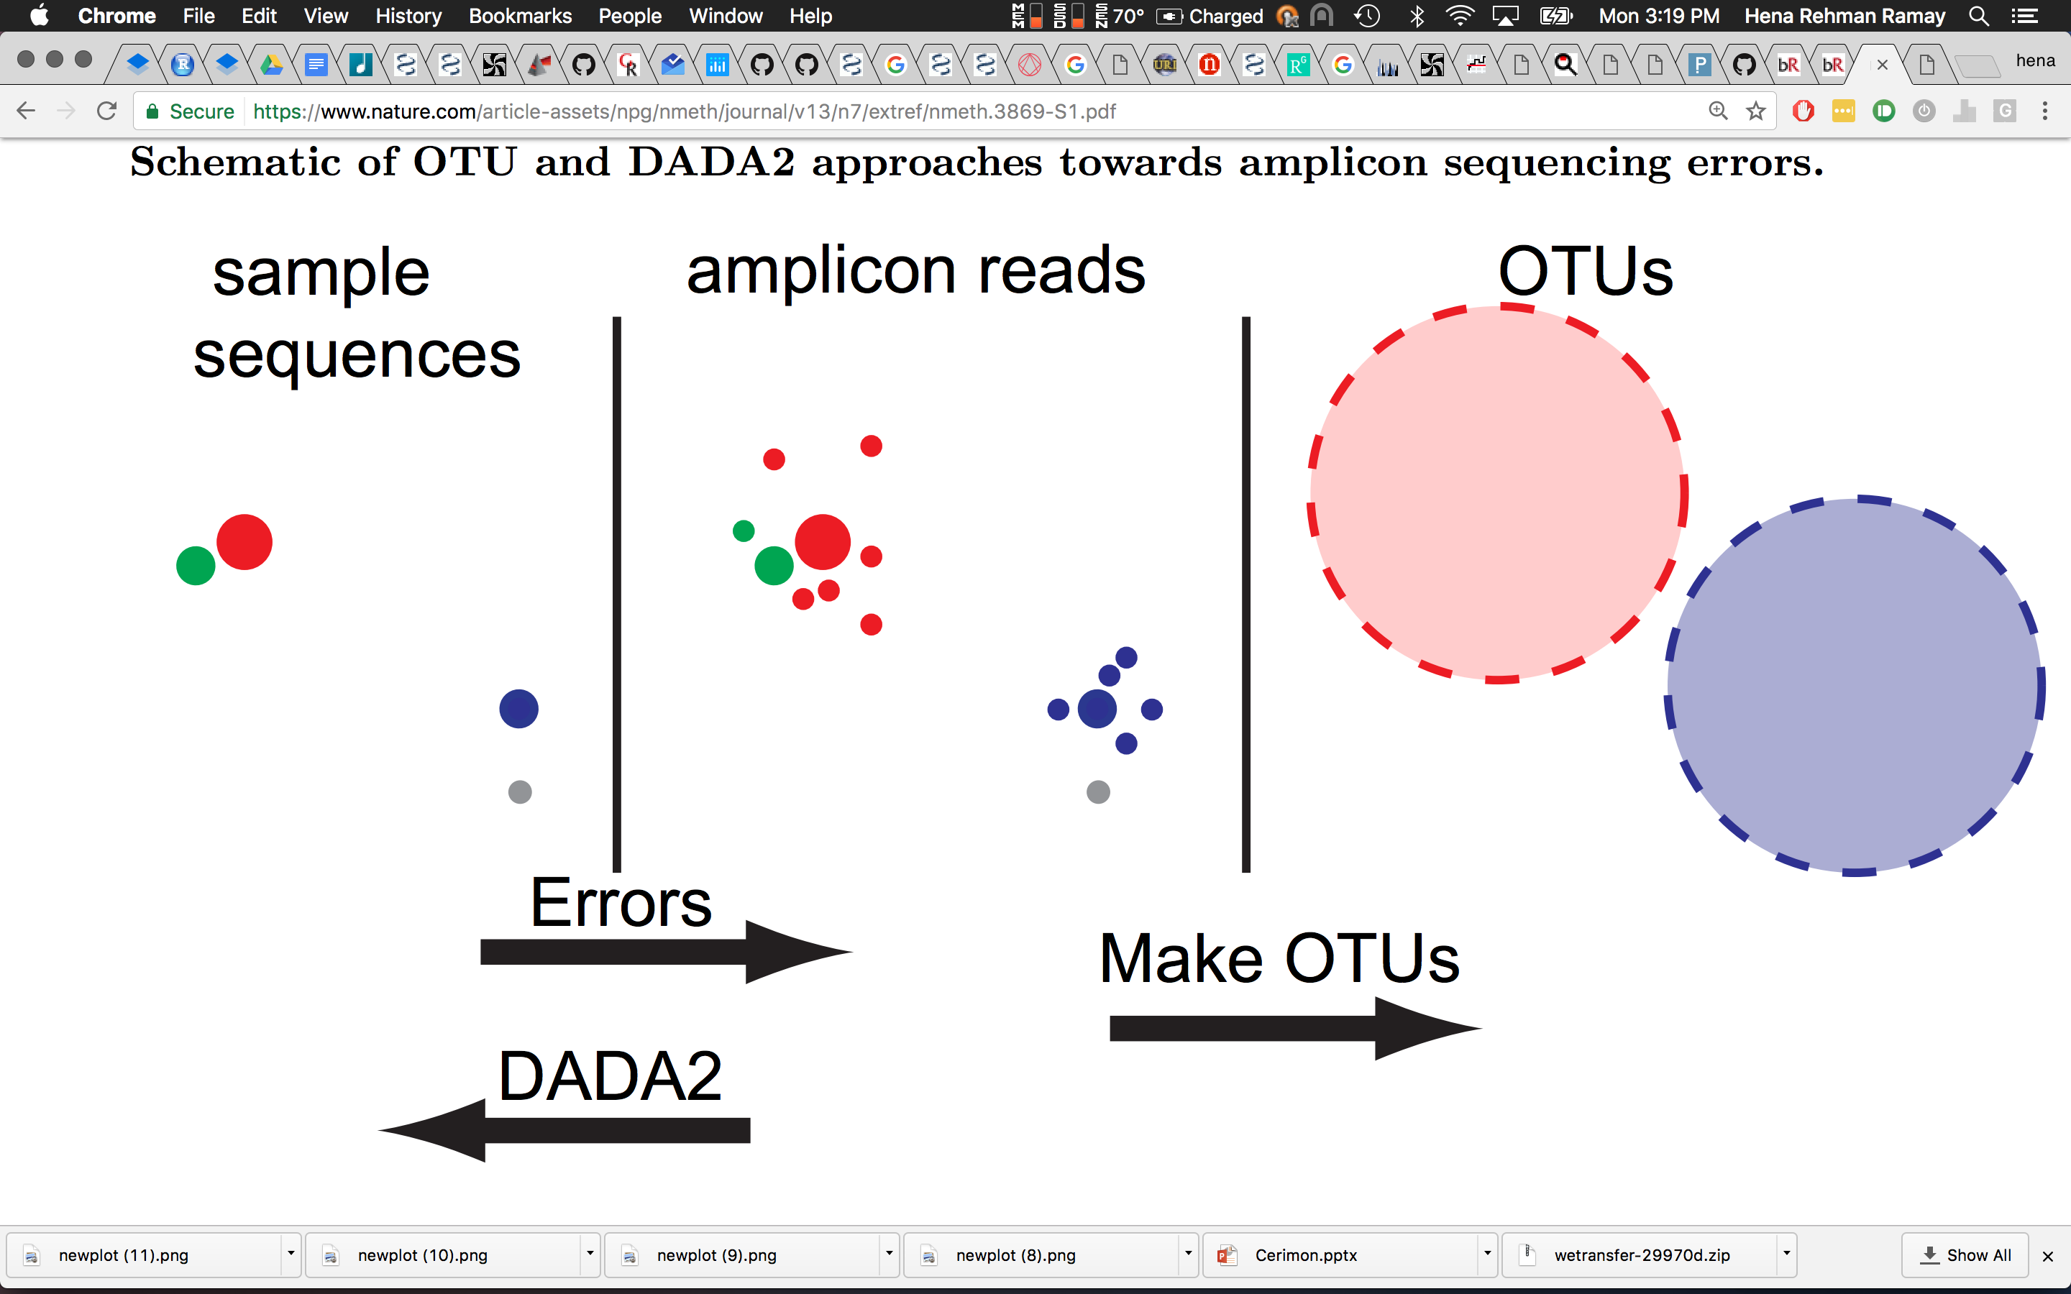
Clustering
(Operational taxonomic Unit)
97 % Identity
97 % Identity
(OTUs are not strains)
OTUs: Lump similar sequences together
DADA2: Statistically infer the sample sequences (Amplicon sequence variants: ASVs)
Source: Callahan et al.,2016

Slide 31
Clustering
97 % Identity
97 % Identity
DADA2
High Resolution & Accuracy
Source: Callahan et al.,2016
Notes:
High Resolution: DADA2 infers exact sequence variants from amplicon data, resolving differences of even 1 or 2 nucleotides.
Accuracy: DADA2 reports fewer false positive sequence variants than other methods report false OTUs.

Slide 32
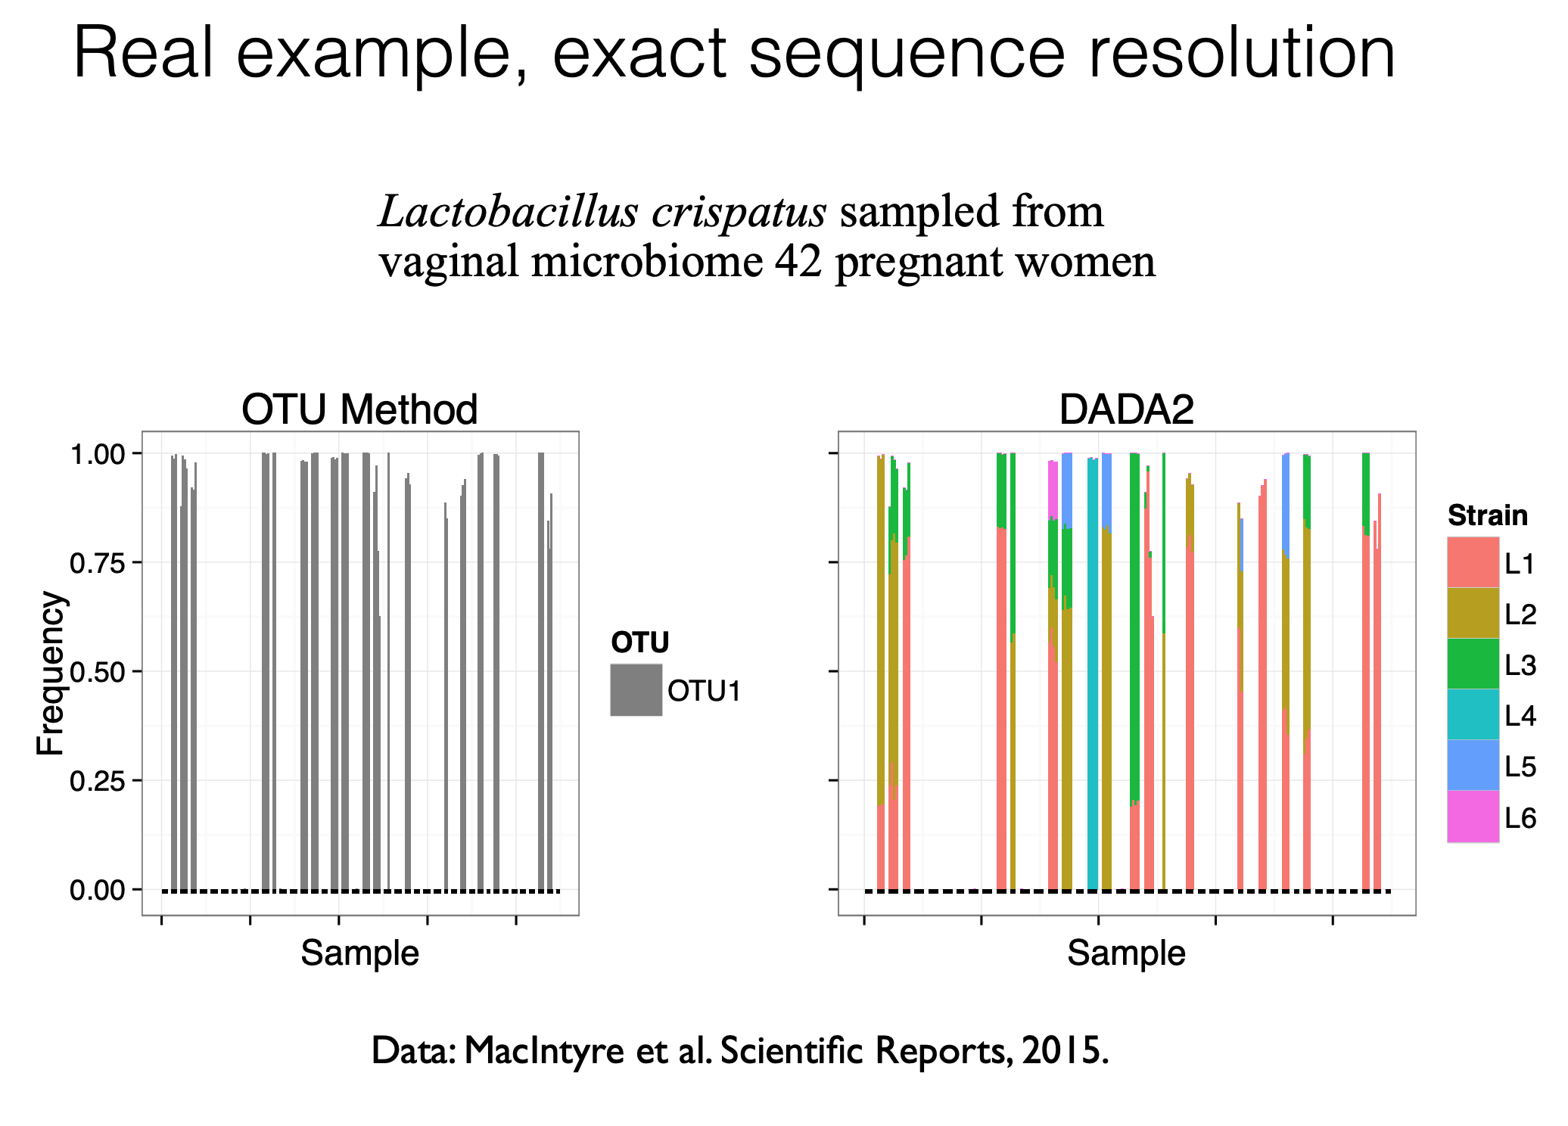

Slide 33
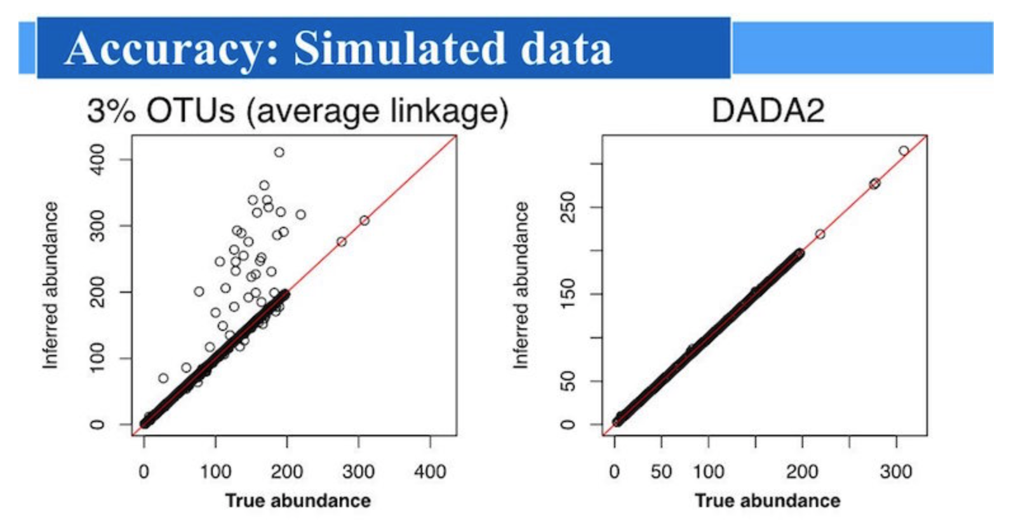
Clustering
Don’t cluster unless you have a very good reason to do so.

Slide 34
Merge Paired End Reads
Overlap
FWD
Primer
Read length
REV
Chimeric Sequences
Biological Sequence X
Biological Sequence Y
Chimera formed from X and Y
Created during PCR
Fragment primes different extension
About 1-5 % of reads are chimeric
Source: Lahr & Katz, 2009
Notes:
Chimeras are sequences formed from two or more biological sequences joined together. Amplicons with chimeric sequences can form during PCR. Although chimeras can be formed by a number of mechanisms, the majority of chimeras are believed to arise from incomplete extension. During subsequent cycles of PCR, a partially extended strand can bind to a template derived from a different but similar sequence.

Slide 35
Reference Databases
&
Taxonomy Assignment

Slide 36
Taxonomy Assignment
Method of reference
Data used for classification
Taxonomic Inference
Available Tools
Alignment-Based
Sequence Alignment
Reference Sequences
Identity thresholds
MEGAN5, RTAX
Composition-Based
Shared Feature Vectors (K-mers)
Shared Feature Vectors & probability of taxonomic inclusion
Quantity or proportion of feature vectors shared between reference and query sequence
RDP Classifier, UTAX
Source : Richardson et al., 2016

Slide 37
SUGGESTIONS
Length & Depth
Know which region, read
length & depth suits your
experiment
Denoise (DADA2)
Remove errors
Know Why
Understand why you are using a tool or method
Negative Controls
Helps identify contaminants
Avoid Clustering
Unless you have a very good
reason, avoid
Sample size
Are there enough samples for
down stream analysis
Document
Make sure your workflow is well documented and reproducible

Slide 38
"If you torture the data long enough, it will confess."
- Ronald Coase, Economist

